Slide 1
Azure Stream Analytics
Microsoft Research

Slide 2

Azure Stream Analytics
Highly scalable service for analyzing data in motion
Analyze data streaming from IoT devices and other sources
Supports SQL-like query language for data analysis
Scales easily using Streaming Units (1 SU ~= 1 MB/sec)
Event Hubs
Event Hubs
Blob Storage
IoT Hubs
Azure SQL Database
Blob Storage
Other Output Sinks
Stream Analytics
Notes:
A good way to characterize Stream Analytics is to say that a database lets you determine how many red cars were sold last year. Stream Analytics lets you determine how many red cars are in the parking lot at any given time.

Slide 3
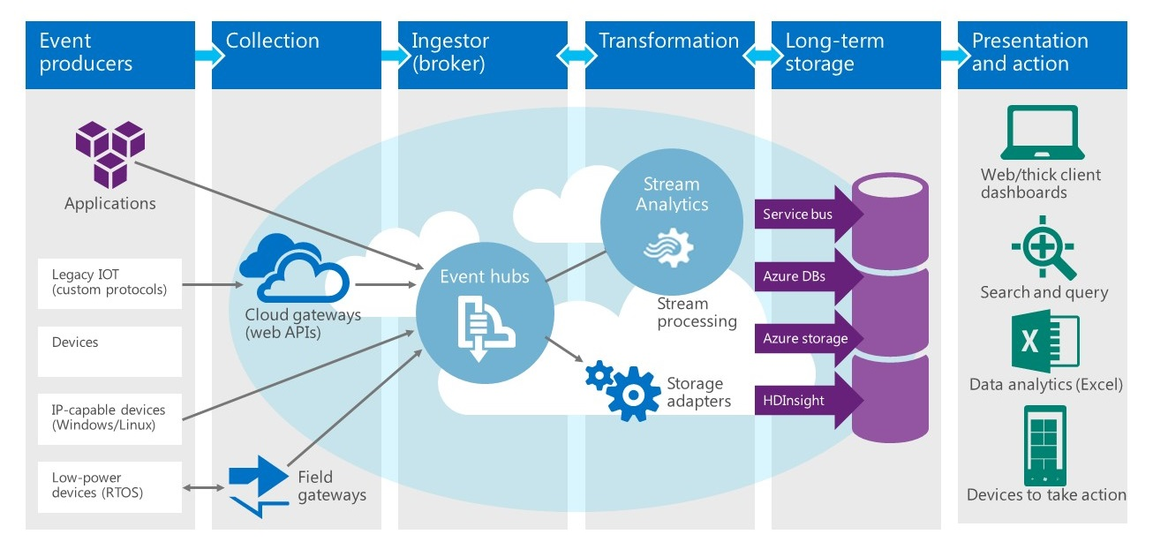
Stream Analytics at Work

Slide 4
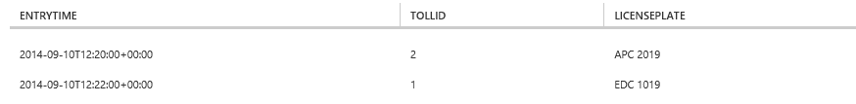
Querying a Data Stream
SELECT EntryTime, TollId, LicensePlate
FROM EntryData
WHERE Make = 'Honda' AND State = 'NJ'
Notes:
This query lists the license plate numbers of all Honda cars with NJ license plates that have entered a toll booth.

Slide 5
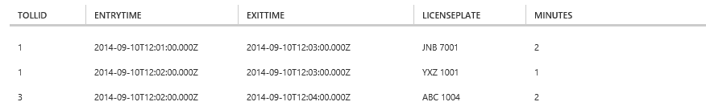
JOINing Two Data Streams
SELECT EN.TollId, EN.EntryTime, EX.ExitTime, EN.LicensePlate,
DATEDIFF(minute, EN.EntryTime, EX.ExitTime) AS Minutes
FROM EntryData EN TIMESTAMP BY EntryTime
JOIN ExitData EX TIMESTAMP BY ExitTime
ON EN.TollId = EX.TollId AND EN.LicensePlate = EX.LicensePlate
AND DATEDIFF(minute, EN, EX) BETWEEN 0 AND 15
Notes:
This query determines how long it took to service each car that entered a toll booth (i.e., the difference between the time the car entered and exited the toll both).

Slide 6
Windowing
Core requirement for stream-processing systems for counting or aggregating events in a specified time period
Tumbling Window
Hopping Window
Sliding Window

Slide 7
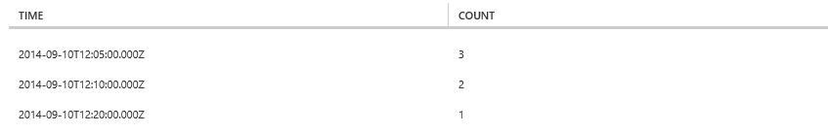
Using TumblingWindow
SELECT System.Timestamp AS Time, COUNT(*) FROM EntryData
TIMESTAMP BY EntryTime
WHERE TollId = 1 AND State = 'NY'
GROUP BY TumblingWindow(minute,5)
Notes:
This query answers the question "how many cars with NY license plates enter toll booth #1 every 5 minutes?"

Slide 8
Using SlidingWindow
SELECT DateAdd(minute,-5,System.TimeStamp) AS [Start Time],
System.TimeStamp AS [End Time], TollId, COUNT(*)
FROM EntryData TIMESTAMP BY EntryTime
WHERE State = 'NJ'
GROUP BY TollId, SlidingWindow(minute, 5)
HAVING COUNT(*) > 1
Notes:
This query answers the question "which toll booths have served two or more cars with NJ license plates in a 5-minute period?"

Slide 9
Hands-On Lab
IoT and Azure Stream Analytics
StreamAnalyticsHOL.html

